Slide 1

Andrew Davison
Competency Portfolio
www.infratec-uk.com

Slide 2
Competency Summary
Category | Accreditation Body | No. | Expiry
IPAF 1b | PAL | OP/2053895 | 31/10/2026
Highways Electrical Registration Scheme | HEA | H1173702 | 18/10/2027
Emergency First Aid at Work | QualSafe Awards | 3369838 | 24/05/2027
Working at Height Level 2 (RQF) | Qualsafe Awards | 3021029 | 15/02/2026
National Highways Safety Passport | National Highways | 14-00045076 | 06/01/2026
CPCS – Crane Lift Supervisor | CSCS | 40990822 | 07/08/2027
www.infratec-uk.com

Slide 3
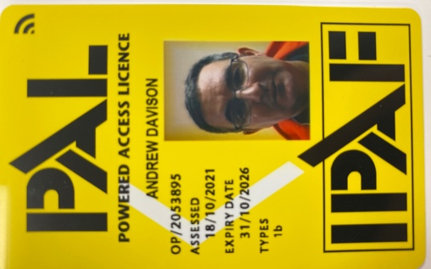

Competency Cards
IPAF
HEA
Highways Passport
www.infratec-uk.com

Slide 4
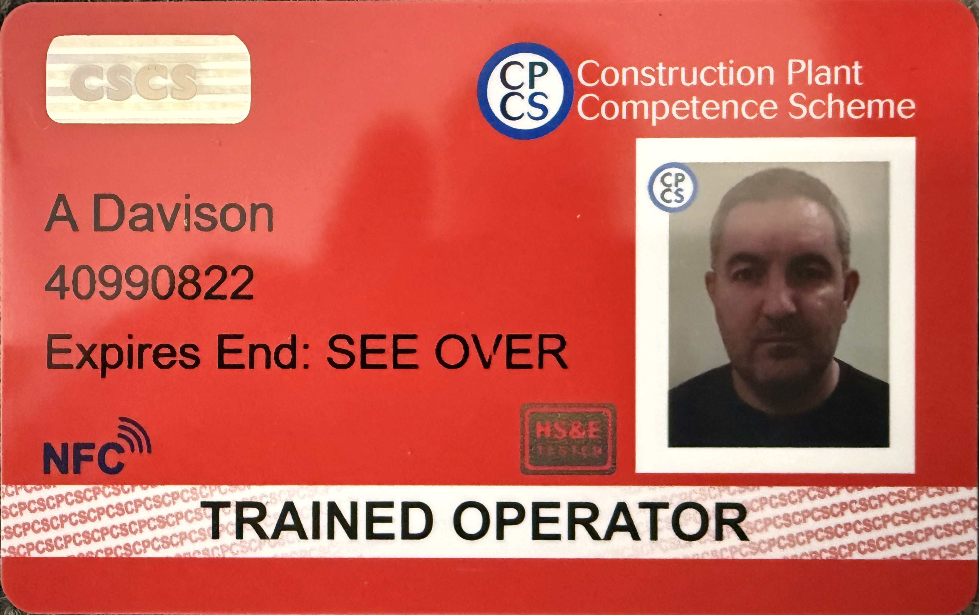
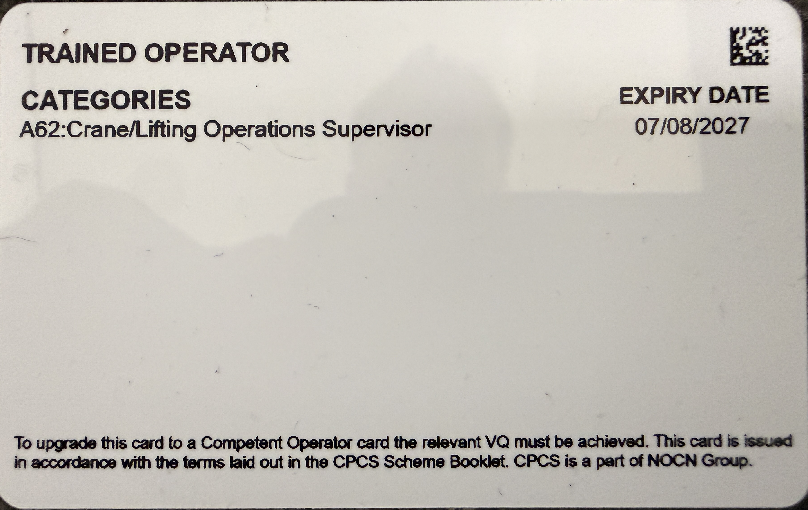
Competency Cards
CSCS
www.infratec-uk.com

